Slide 1

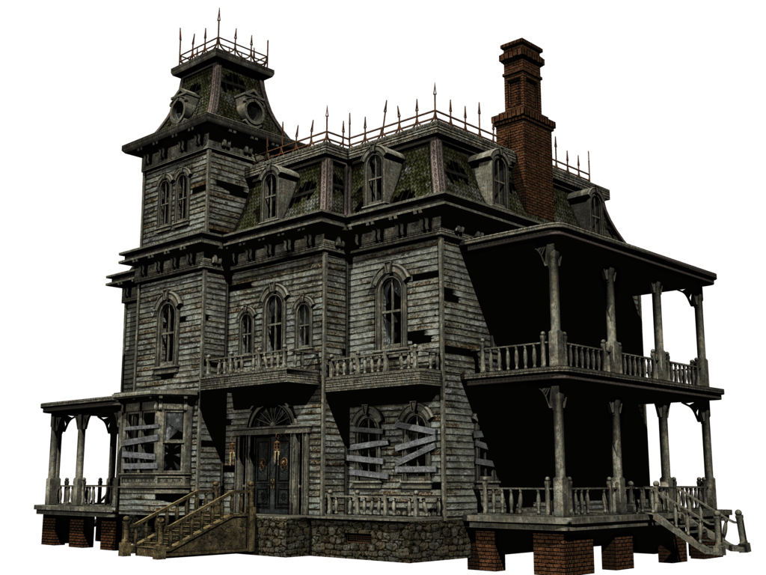


Get Out!!!
Kelly F. Arianna C. Camron B.
AlMighty Tech

Slide 2
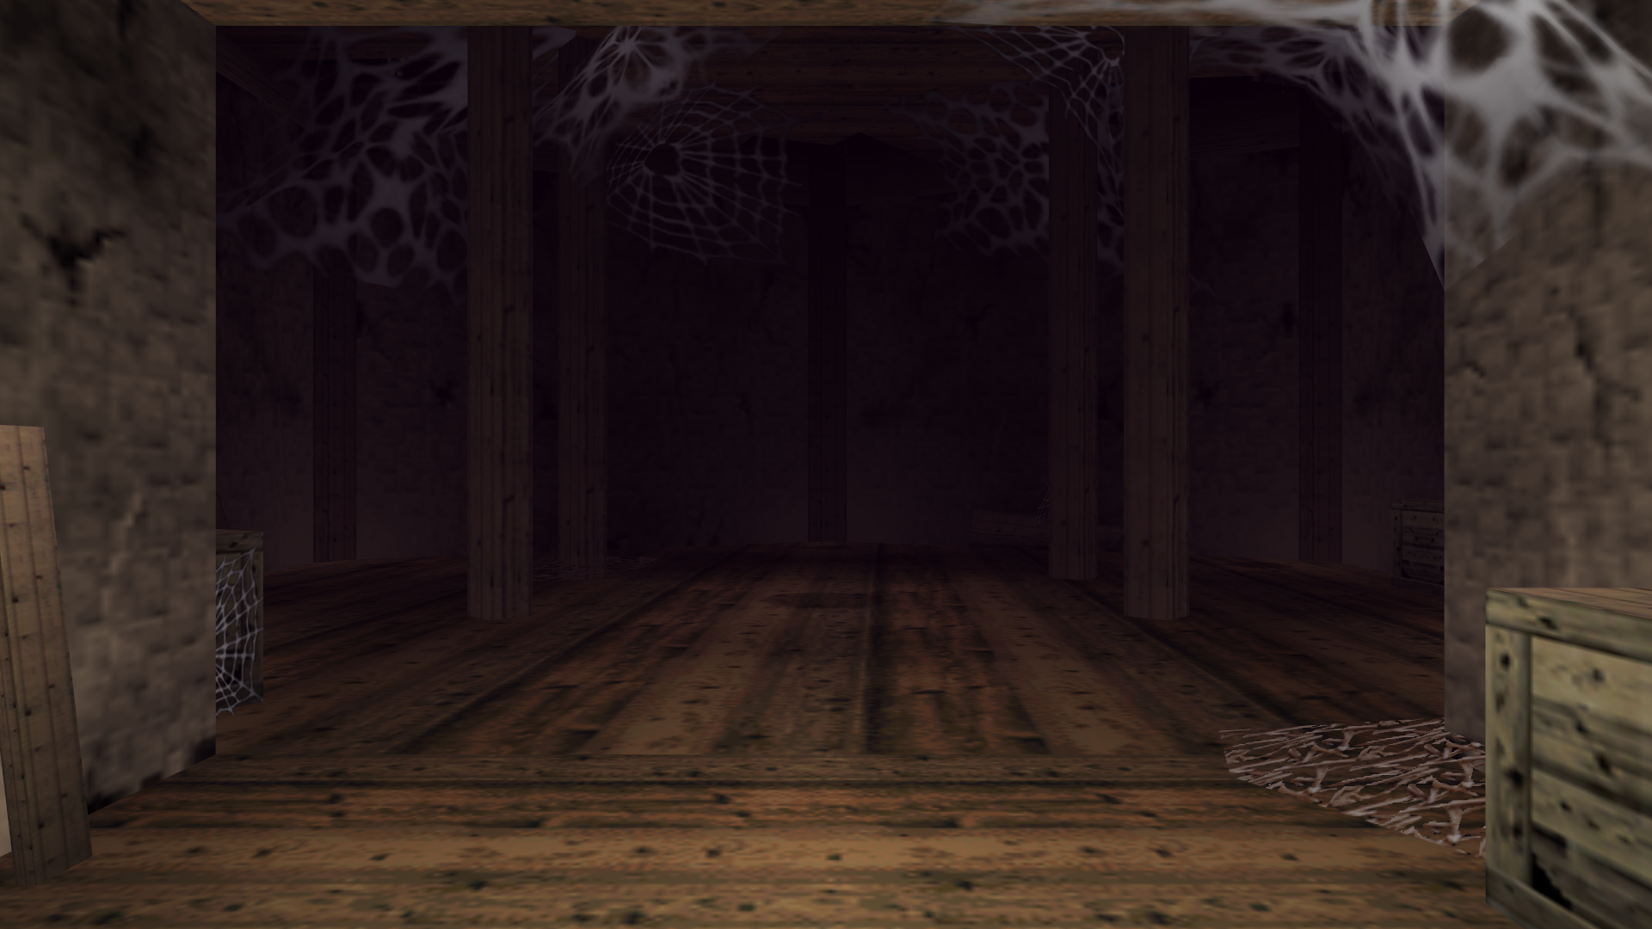
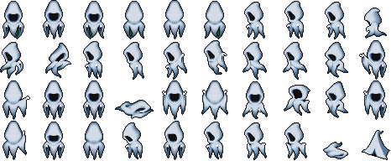
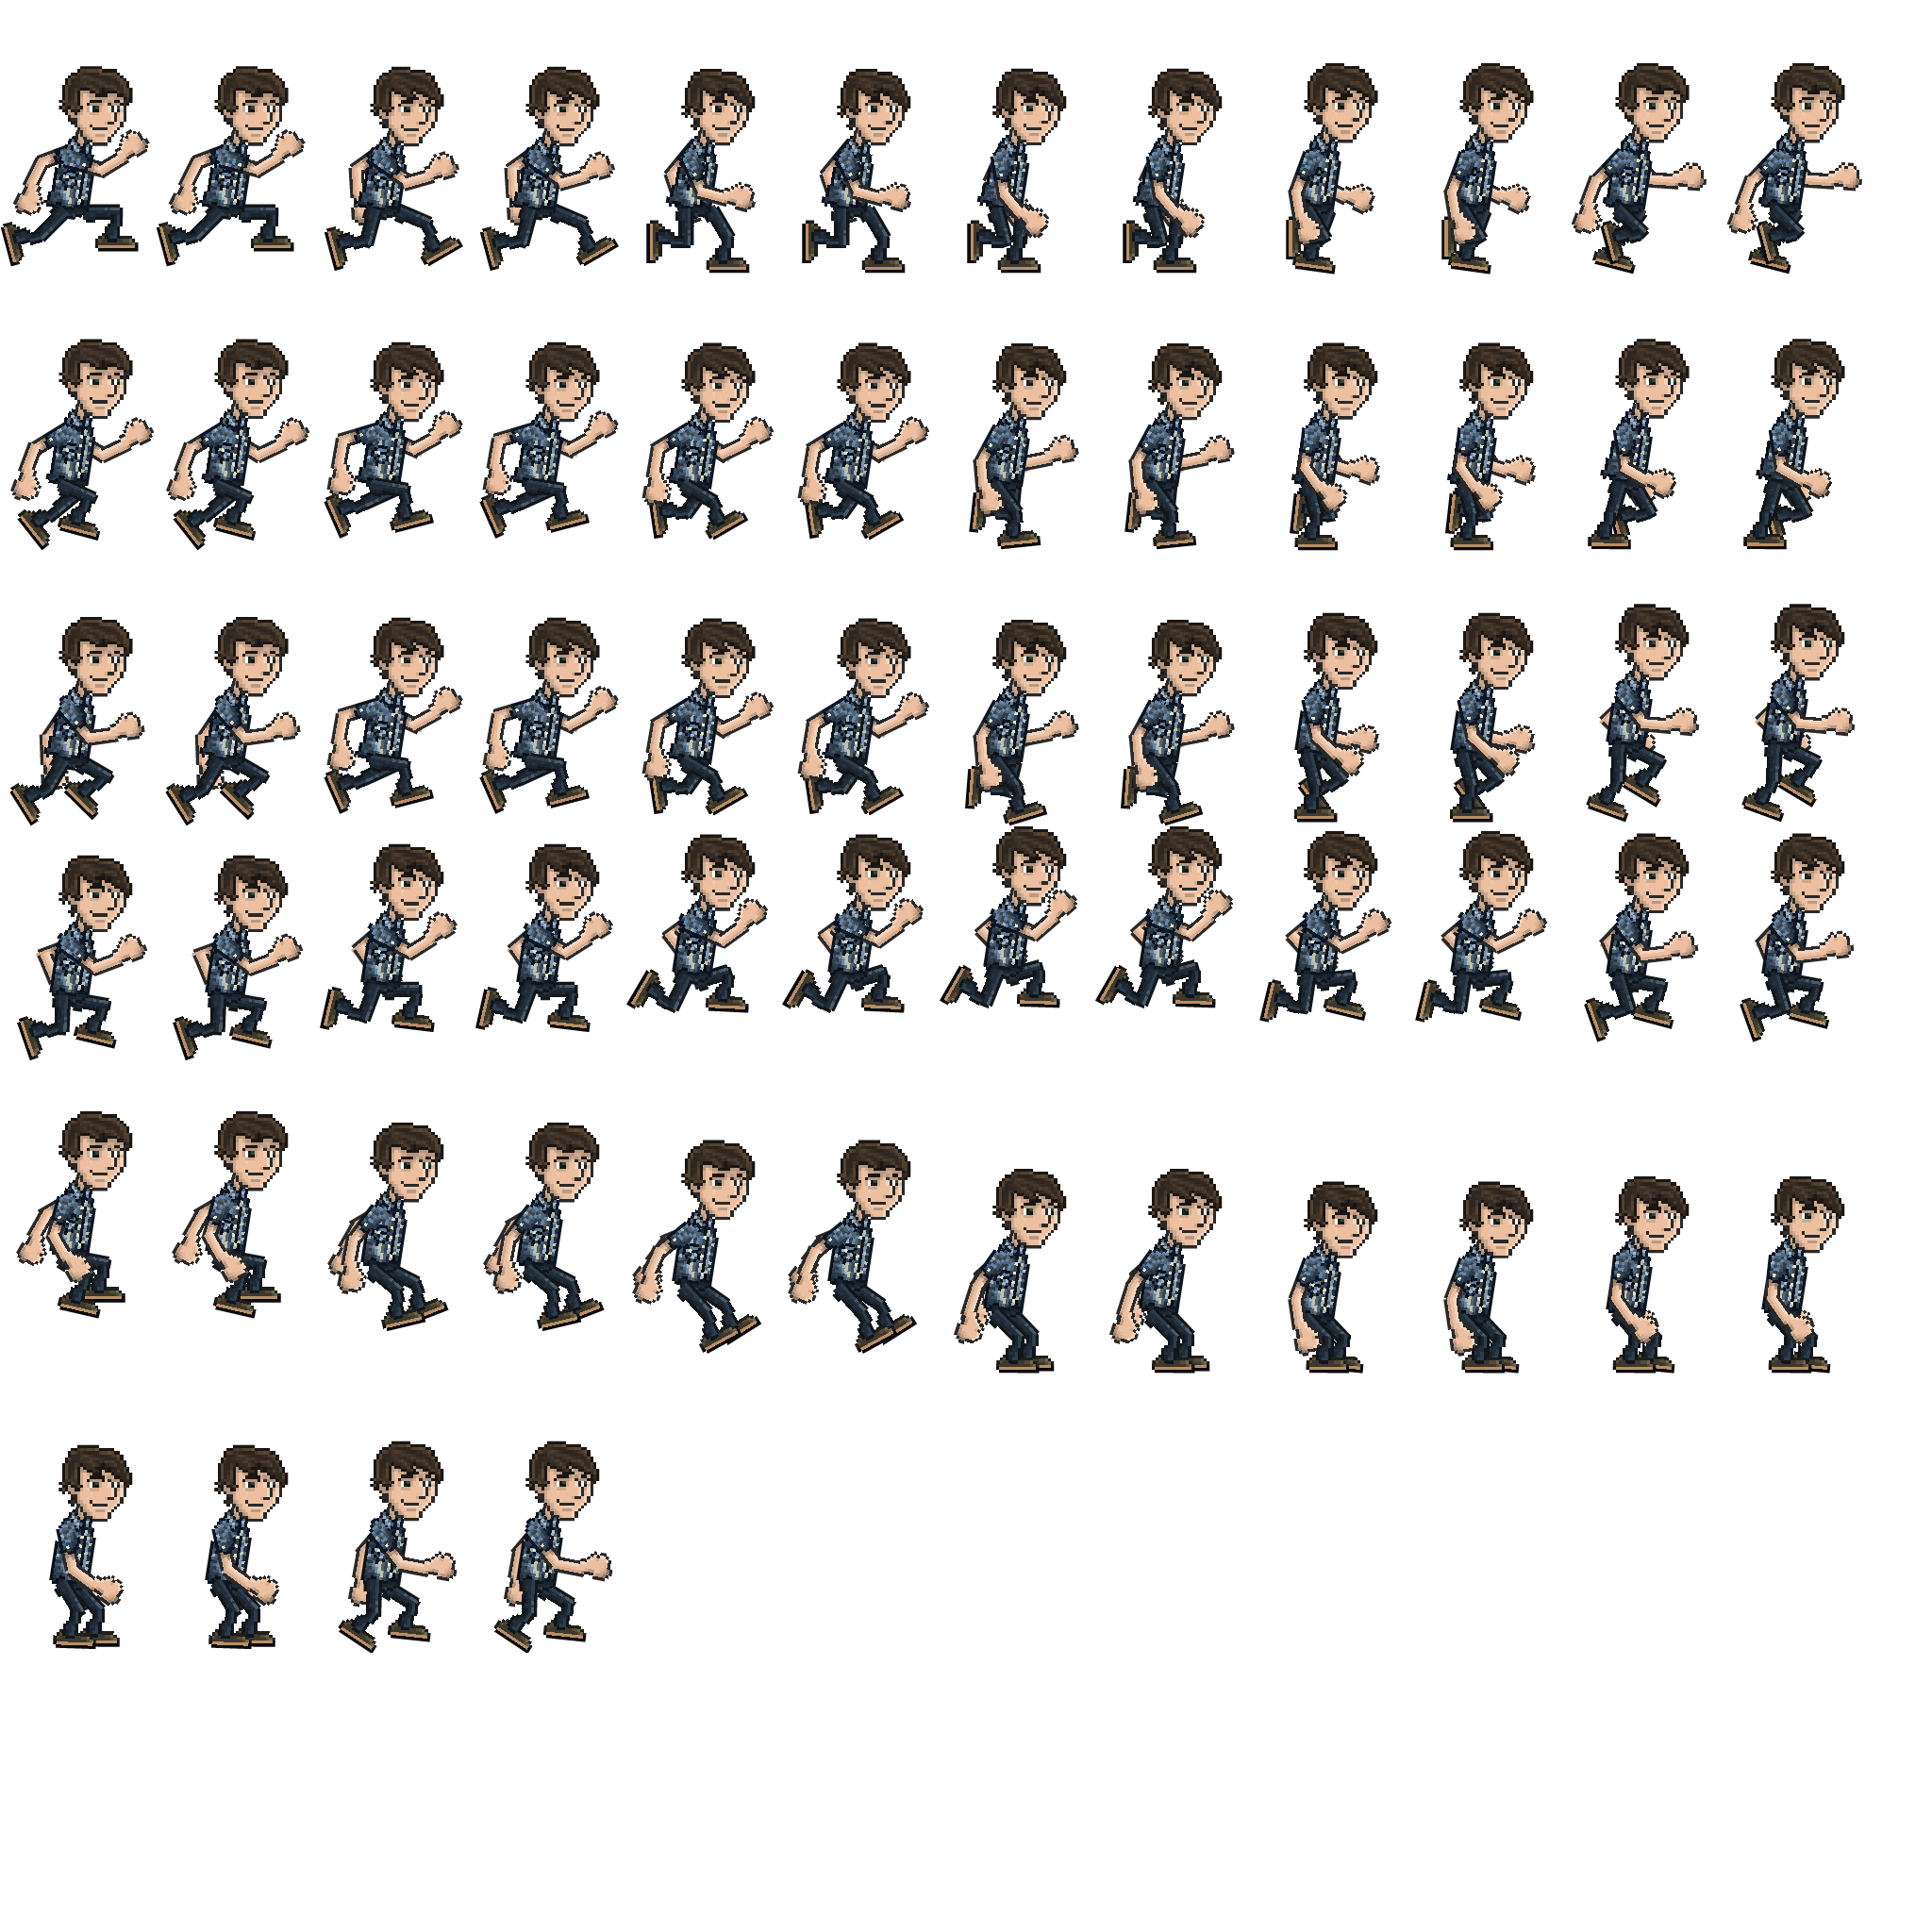
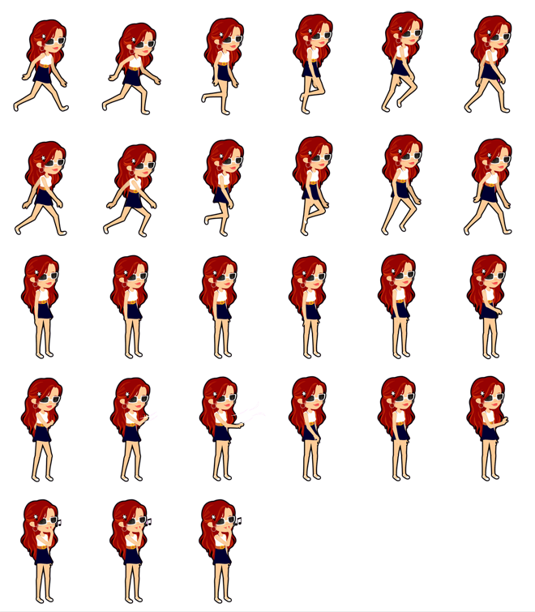

Notes:
Try to get through each room without touching a ghost.

Slide 3

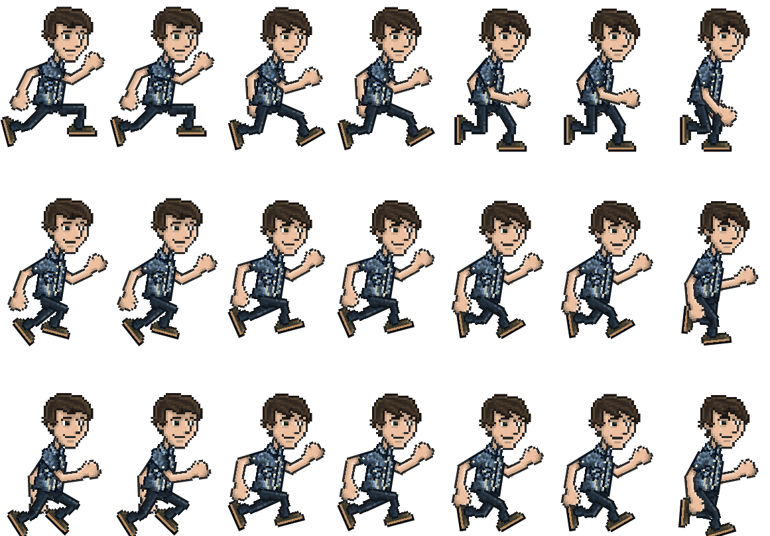
Notes:
If a ghost touches you you will lose health

Slide 4

Go through the hall then go through the door
Notes:
Find notes and different items to help you get out

Slide 5
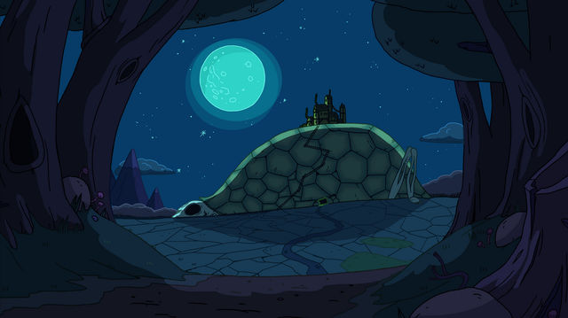
Notes:
Once you get through all the ghosts and find all the clues, you have safely escaped.

